Slide 1

Birth Preparedness and Complication Readiness(BP/CR)

Slide 2
Background
Deliveries attended by skilled health personnel are one of the most important interventions to reduce maternal and child mortality.
Rather than focusing on birth preparedness and complication readiness planning, in high-income countries, the focus is primarily on women’s psychological and physical comfort but in low-income and middle-income countries, there is a need of emphasis on birth preparation and potential complications.

Slide 3
Introduction
Birth Preparedness and Complication Readiness (BPCR) is an intervention included by WHO as an essential element of the antenatal care package.
It is often delivered to the pregnant woman by the health care provider in antenatal care or initiated or followed up through a visit to the home of the pregnant woman by a community health worker.

Slide 4
Birth Preparedness
Birth preparedness and complication readiness (BP/CR) is a process of planning for normal birth and anticipating the actions needed in case of an emergency and it is a comprehensive package designed to address delays by empowering women, her family, and the community to improve planning for birth and take actions in case of an emergency.

Slide 5
In addition to working with an individual pregnant woman, programmes often address efforts to her family and to the broader community to increase awareness on BPCR or to improve health workers’ skills to provide BPCR as part of ANC.
Programmes often provide education materials or other visual aids with BPCR information, or may implement mass media campaigns with BPCR messages.

Slide 6
To be able to be prepared for birth and possible complications, women, families and communities need to know about signs of onset of labour as well as danger signs during pregnancy and after birth of the woman and newborn.
BPCR interventions have evolved and while originally programmes focused largely on care-seeking for the woman, in recent years, programmes have recognized the value of discussing care-seeking for newborn complications.

Slide 7
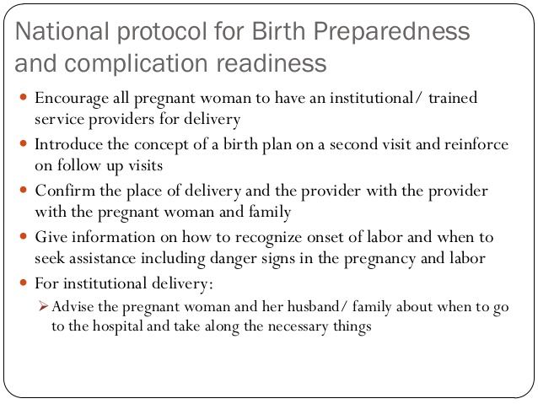

Slide 8
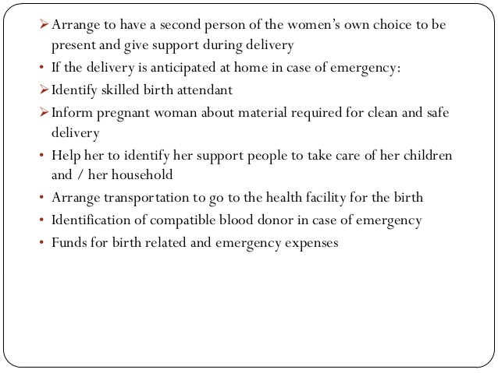

Slide 9
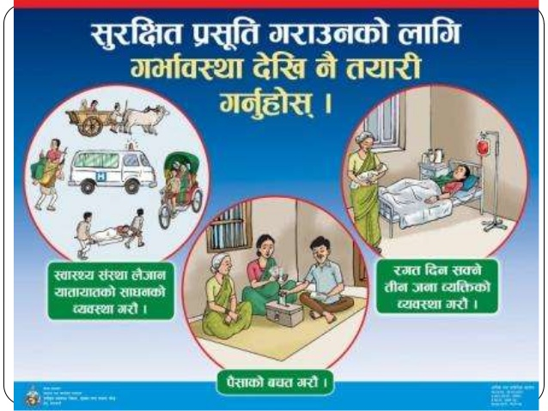

Slide 10
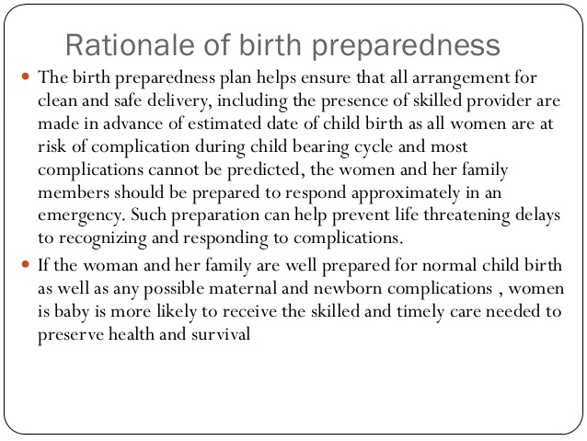

Slide 11
Components of B.R
Components of birth preparedness and complication readiness plan includes; identifying a place of delivery, saving money, preparing essential items for childbirth, identifying a skilled provider, identifying a mode of transportation, arranging blood donors, arranging a way for communication, designating decision maker on her behalf, identifying emergency funds, being aware of the obstetric danger signs & the need to act immediately.

Slide 12
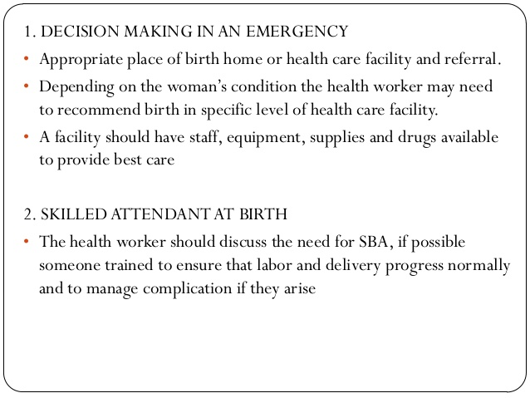

Slide 13
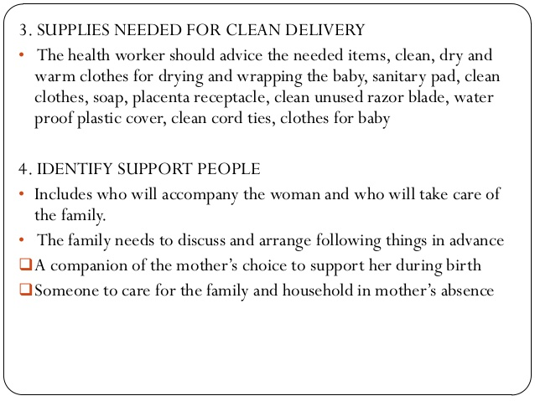

Slide 14
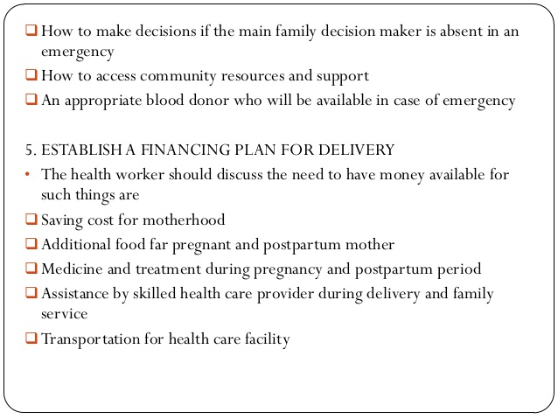

Slide 15
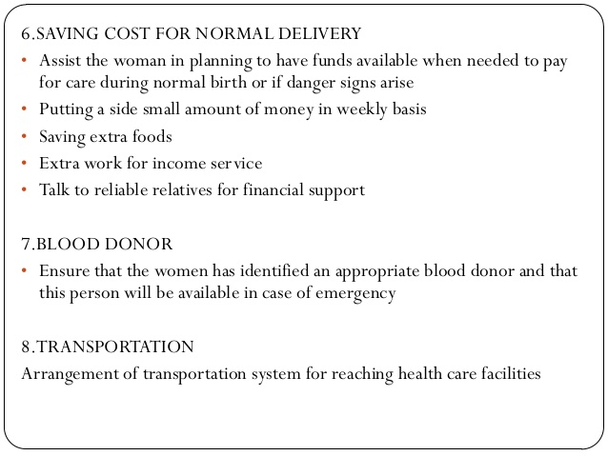

Slide 16
